Slide 1

A Cloud-based Smart Home Control System
An IOC simulation experiment

Slide 2
Introduction

Slide 3

Our Project goal
Our project wants to design a system (simulation) that includes the control functions of various household appliances. The system's architecture includes a smartphone front end, a Raspberry Pi device as a gateway, and the cloud as a hosting environment for all other command processing systems.
We also aim to define a unified set of interfaces for the smart home.

Slide 4
My motivation
The Internet of Things is growing, but testing IoT applications and backend services without a large number of connected devices can be a challenge.
To help users who lack physical devices test device integration and IoT backend services more easily, we want to provide an IoT device simulator solution. The solution provides a web-based graphical user interface (GUI) console, eliminating the need for customers to configure and manage physical devices or develop time-consuming scripts

Slide 5
Background

Slide 6
Project background
The development of ZigBee, RFID, NFC and other short-range communication networks means that we can establish a cheaper and reliable home intranet, and the popularity of smart phones provides people with an intelligent terminal that can access the Internet anytime and anywhere.
With the development of open source project: rabbitmq/flask/python3/tkinter, we can simulate IOT more easily
With the aim of our project, developer and people who are interested in smart home can experience the Internet of Things more conveniently

Slide 7
The Problem

Slide 8
The Problem
Anyone interested in a smart home, but IoT hardware doesn't come cheap. Testing IoT applications and backend services can be a challenge without a large number of connected smart devices.
What is the software and hardware combined solution that can simplify the testing of IoT smart homes and get started?

Slide 9
The Solution

Slide 10
Project dataflow Architecture
1. UI for user operation, we designed the online platform using bootstrap/jinja/flask
2. The operation action communicates with the IOT client. The event is triggered by the template page of Jinja on the front end of rabbittimq, and then passed to the pika middleware through the Flask API, and pika is then passed to rabbitmq
3. The GUI that rabbitmq sends to physical hardware simulation of various electrical appliances

Slide 11
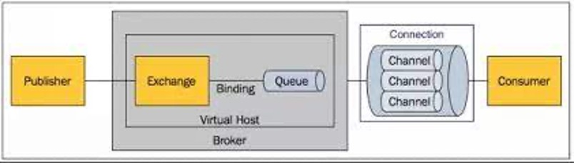
Rabbitmq Message flow

Slide 12
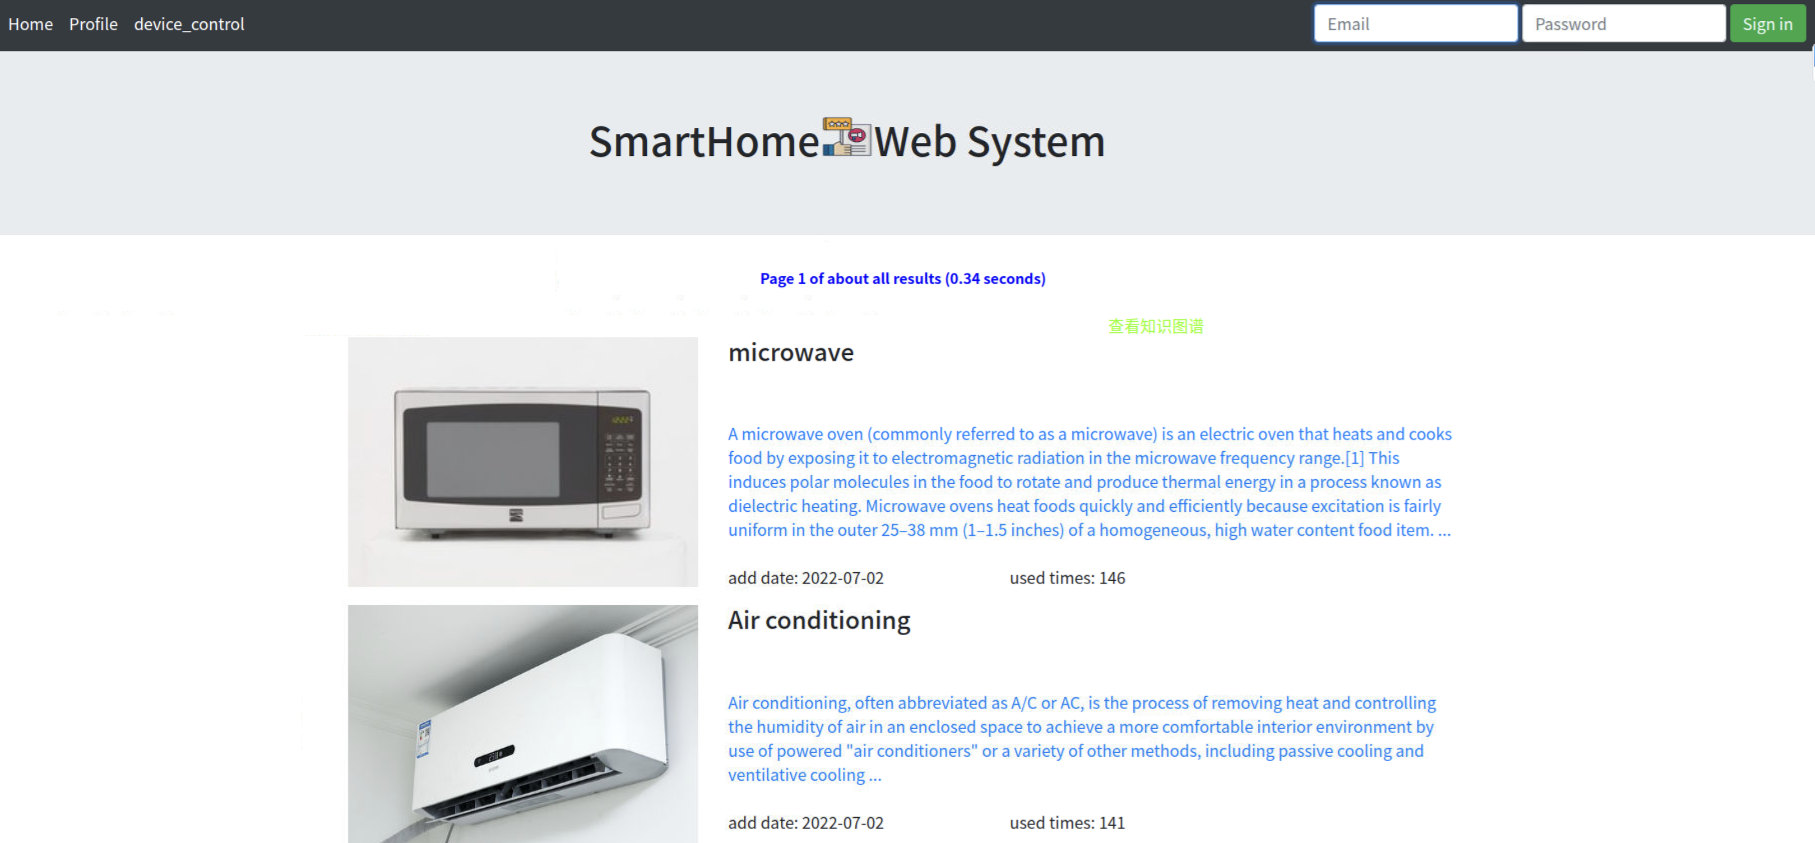
Web front end

Slide 13
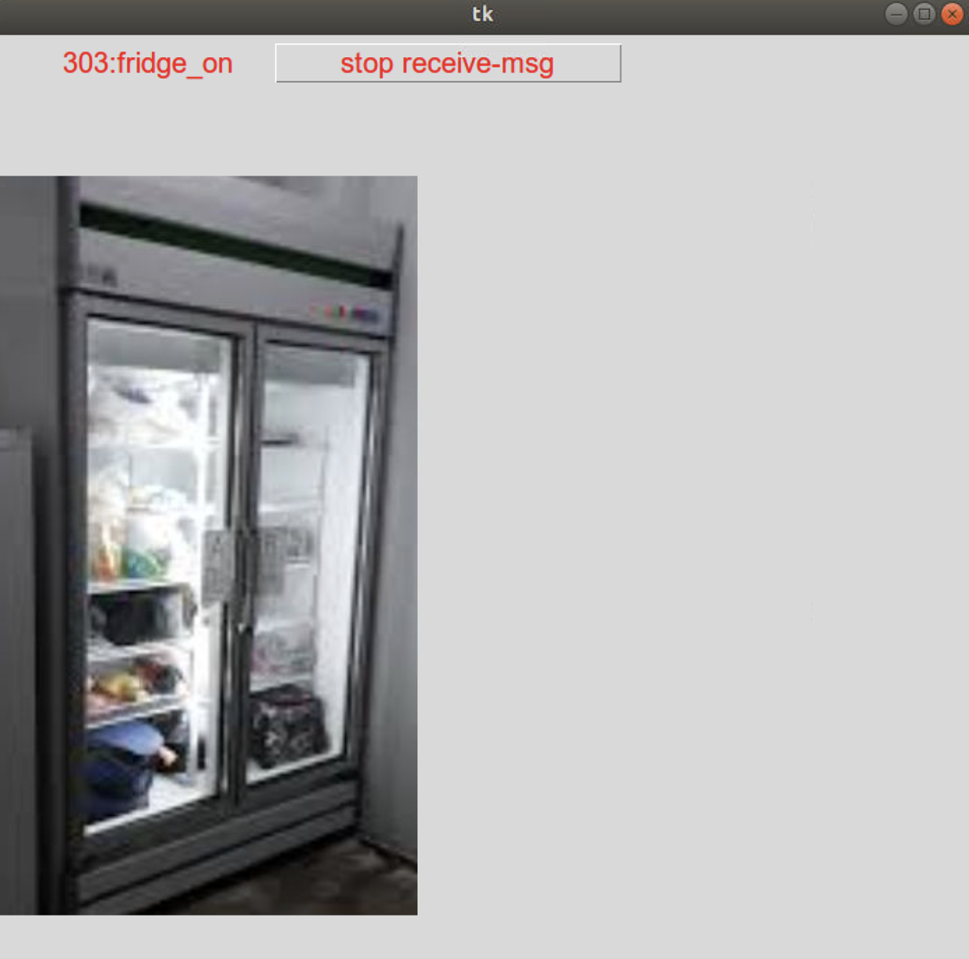
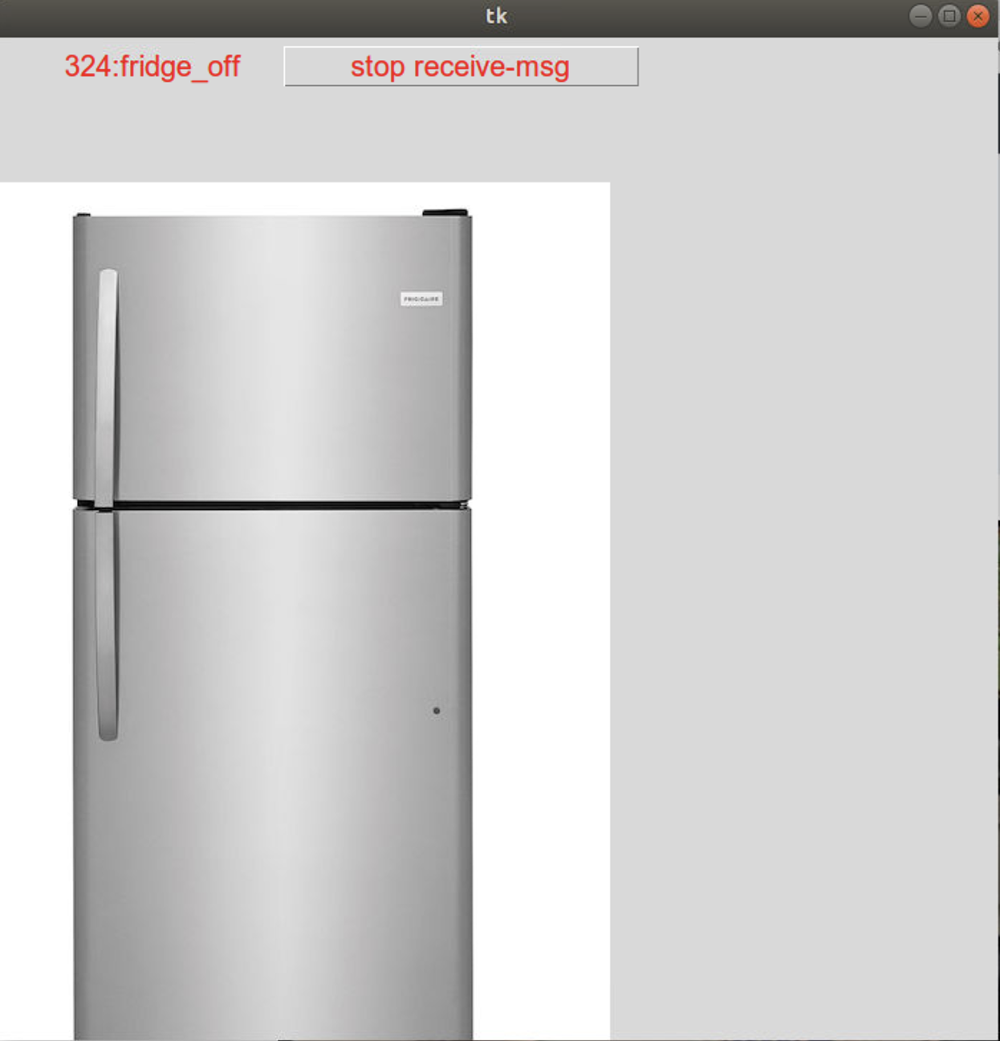
GUI client

Slide 14
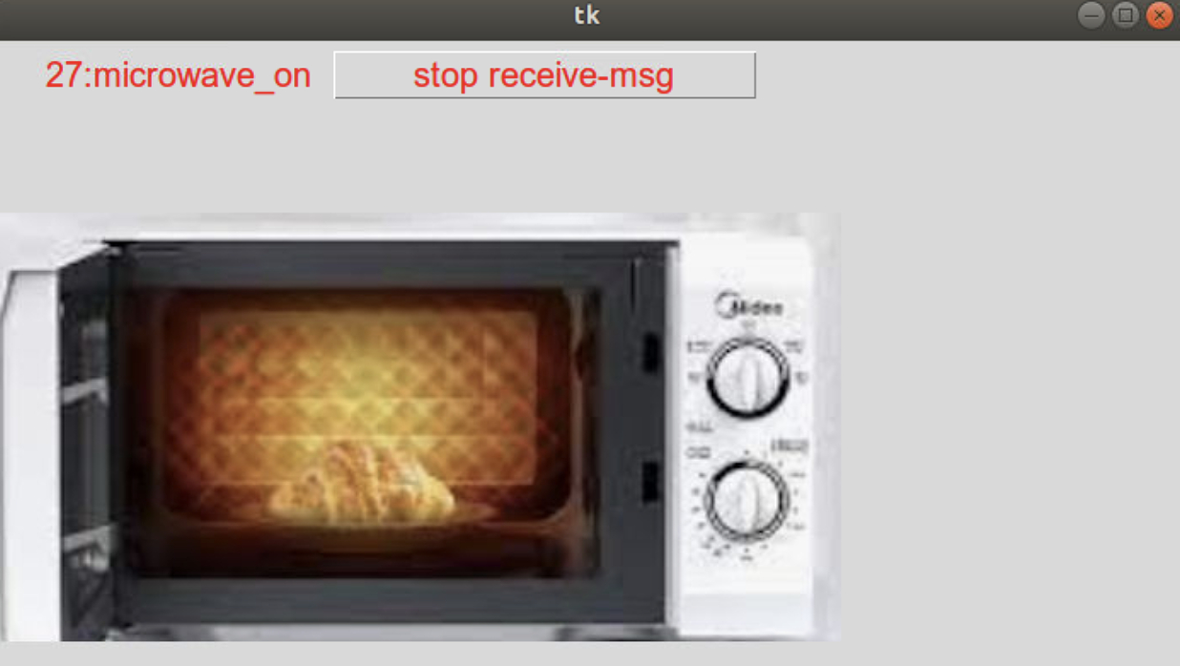
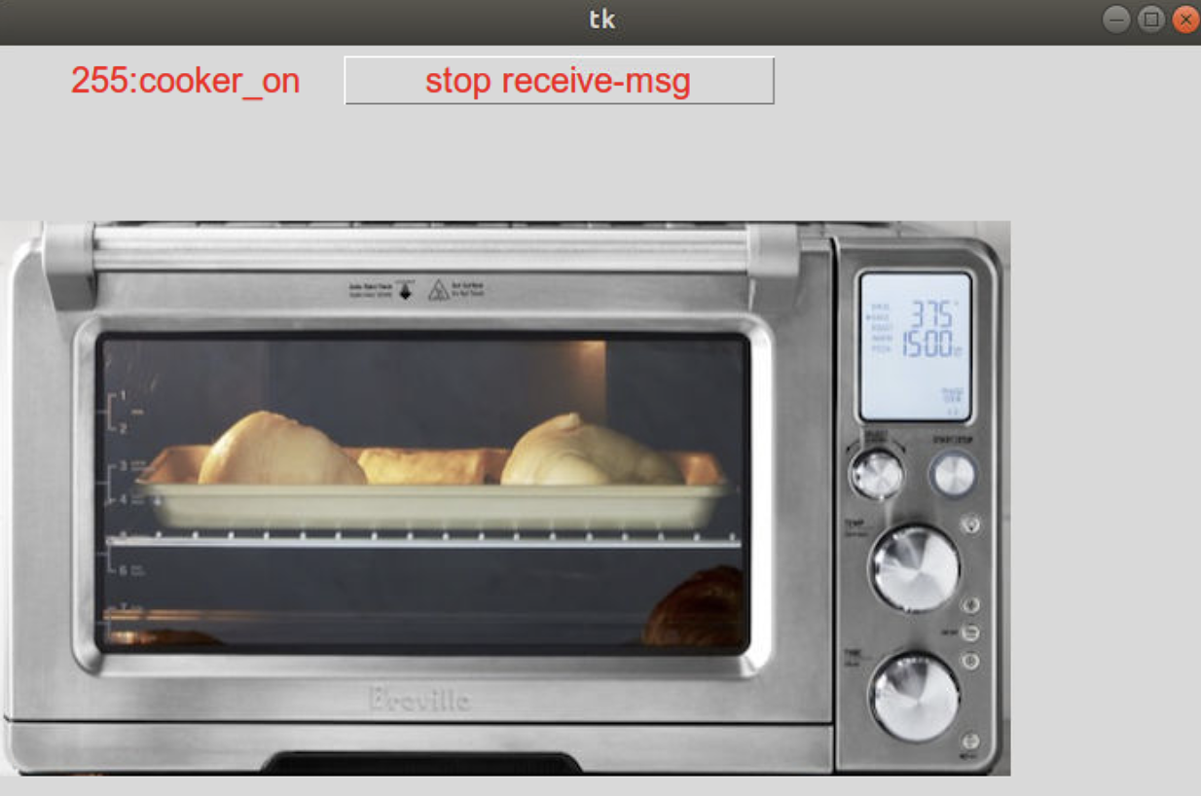
GUI client

Slide 15
Evaluation & Conclusions

Slide 16
Experimental Evaluation and Conclusions
Relying on our software system and Raspberry Pi ARM-based hardware, our simulations can cover most common hardware-software interactions of home IoT hardware.
Our software solutions can be easily extended to real IoT hardware for deployment and testing

